Slide 1
FULL STACK DEVELOPMENT
GROUP – 11 (A)

Slide 2
TEAM MEMBERS
J. Ajay Surya
01
02
Mohitha Velagapudi
CB.EN.U4AIE21018
CB.EN.U4AIE21032
04
03
M. Prasanna Teja
P. Sai Ravula
CB.EN.U4AIE21041
CB.EN.U4AIE21035

Slide 3
Bite2Burn: Nutritional Insight and Fitness Tracking Application

Slide 4
01
Problem Statement

Slide 5
“This project focuses on developing Bite2Burn: An AI powered application that provides accurate calorie counting, personalized suggestions on meals, and targeted nutritional guidance for improved health outcomes.”

Slide 6
Project Outline
02

Slide 7
Challenges
Objectives
Inaccurate Self-Reported Data: Users often underestimate or overestimate their calorie intake, leading to inaccurate tracking and ineffective weight management strategies.
Lack of Personalization: Generic dietary advice fails to account for individual needs, preferences, and dietary restrictions, reducing user engagement and limiting the effectiveness of recommendations.
Develop an AI-powered system for accurate calorie estimation: This system will utilize the Indian Composition Food Tables pdf published by the National Institute of Nutrition, for providing accurate calorie content information about general foods. It will also provide users with personalized suggestion on how many calories to consume based on their personality, and how to burn them too!

Slide 8
04
Data Description

Slide 9
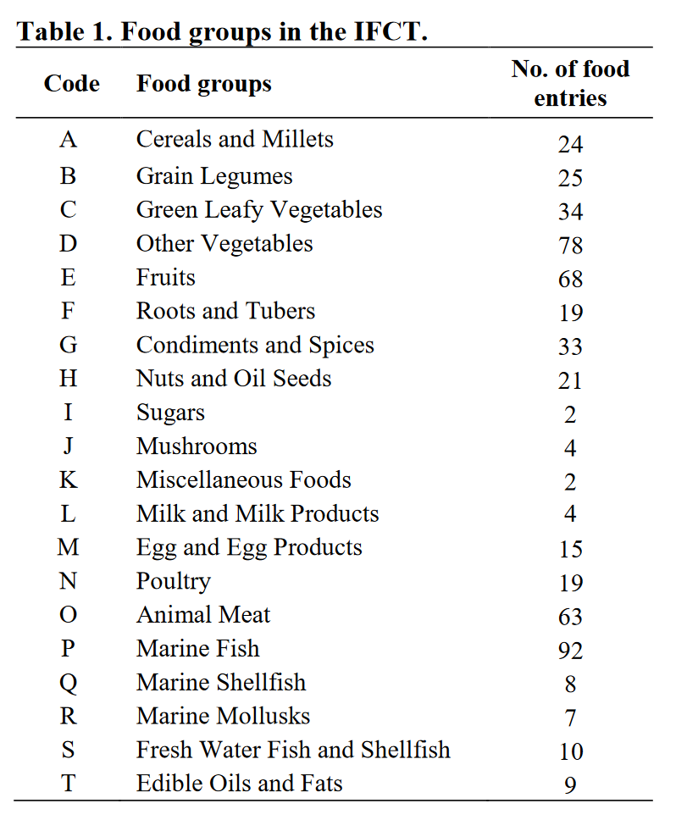
Indian Food Composition Tables
Indian Food Composition Tables (IFCT) 2017 is the major source of food composition data in India, generated, developed, managed and maintained by the National institute of Nutrition (ICMR).
The uniqueness of the IFCT is that all nutrient values presented here have been derived from comprehensive national food sampling followed by analysis and contains only analytical data.
Foods with common characteristics have been placed together and arranged in groups (Table1).
All foods have been categorized into 20 food groups and the number in parenthesis indicates the total number of foods present in each group.
A total of 528 foods have been analyzed for more than 150 parameters and presented under different nutrient component parameter.

Slide 10
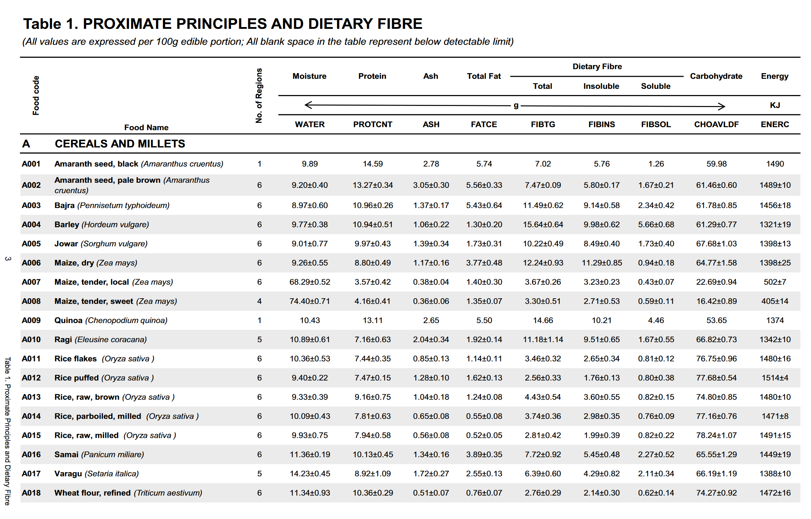
Dataset Table I : Overview

Slide 11
05
Methodology

Slide 12
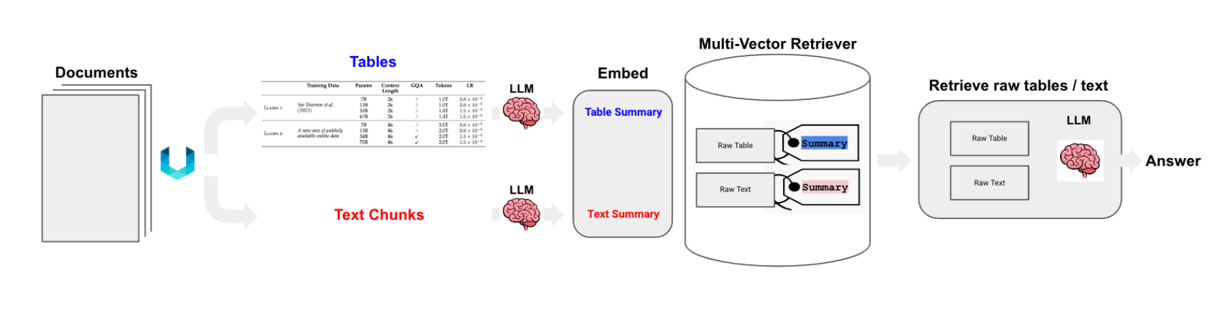
Bite2Burn Backend Architecture

Slide 13

Bite2Burn Backend Architecture: A Detailed Report
The system leverages a combination of Large Language Models (LLMs), vector databases, and a Retrieval Augmented Generation (RAG) pipeline to provide accurate and efficient responses.
I. Data Ingestion and Preprocessing:
Input Data: The system begins with a semi-structured Indian food composition table PDF as input. This PDF contains nutritional information organized in tabular format.
PDF Chunking: The initial step involves splitting the large PDF document into smaller, manageable text chunks. This improves processing efficiency and allows for parallel processing of individual chunks.
Text and Table Extraction: The chunked data is then processed to identify and separate textual content from tabular data. This stage involves Optical Character Recognition (OCR) to convert scanned pages into searchable text, followed by YOLO algorithm to detect and delineate tables based on formatting cues (e.g., rows, columns, borders)
Data Categorization: The extracted data is categorized into two streams: text chunks and tables. This separation is crucial because different processing methods will be applied to each.

Slide 14


Bite2Burn Backend Architecture: A Detailed Report
II. Summary Generation:
LLM Summarization: The Mistral 7B Instruct model (Hugging Face transformer model) is employed to generate summaries for both the extracted text chunks and tables. This process condenses the information, making it easier for subsequent stages to process.
Summary Linking: The generated summaries are linked back to their corresponding raw text chunks and tables. This crucial step maintains the relationship between the original data and its condensed representation. A unique identifier system is likely in place to ensure proper mapping.
III. Embedding and Vector Database Storage:
Vector Embedding Generation: The raw text chunks, tables, and their corresponding summaries are converted into vector embeddings using the FastEmbed library. The dimensions of the generated vector embeddings is 384.
ChromaDB Storage: The generated vector embeddings are stored in ChromaDB, a multi-vector retrieval database. This database allows it allows us to store and retrieve multiple vector representations for a single data point

Slide 15

Bite2Burn Backend Architecture: A Detailed Report
IV. Query Processing and Answer Generation:
Query Embedding: When a user submits a query, it's first converted into a vector embedding using the same FastEmbed library used in the previous step, ensuring consistent representation.
Similarity Search: The query embedding is compared against the vector embeddings stored in ChromaDB. The database efficiently returns the most similar embeddings (i.e., the text chunks, tables, and summaries that are most relevant to the query) based on calculated similarity scores (cosine similarity). This is the core of the RAG pipeline.
Context Retrieval: The top-scoring embeddings (along with their associated raw text and tables) are retrieved and provided as context to the next stage.
Llama 3.1 Response Generation: Finally, the retrieved context is passed to the Llama 3.1 LLM (another Hugging Face model) to generate a concise and accurate answer to the user's query. The LLM uses the contextual information to formulate a coherent and informative response.

Slide 16
Technology Stack
I. Large Language Models (LLMs):
Mistral 7B Instruct (Hugging Face): This powerful LLM is used for generating concise and informative summaries of both textual and tabular nutritional data extracted from the input PDFs. Its instruction-following capabilities ensure high-quality summaries tailored to the context.
Llama 3.1 (ollama): This LLM serves as the core of the question-answering system. It takes the user's query and the retrieved context (raw text, tables, and summaries) to formulate accurate and comprehensive answers. The choice of Llama 3.1 likely reflects its strengths in generating natural and informative text.
II. Vector Database:
ChromaDB: This is a crucial component for efficient similarity search. ChromaDB stores the vector embeddings generated from the nutritional data, enabling rapid retrieval of the most relevant context for each user query. We chose ChromaDB as it is a scalable and performant vector database suited for the application's needs.

Slide 17
Technology Stack
III. Embedding Generation:
FastEmbed: This library is responsible for converting the raw textual and tabular data (along with generated summaries) into vector embeddings. FastEmbed's efficiency is critical for timely processing of large datasets.
IV. Document Processing:
Unstructured: This library plays a key role in handling the initial semi-structured data (the nutritional PDFs). Unstructured is used for the extraction of both textual content and tabular data from the input PDFs. This choice reflects the need for a robust library capable of handling variations in PDF formatting.
V. Programming Language:
Python: Python is the selected programming language for this project. This choice is common for machine learning projects due to the extensive availability of libraries like LangChain, Unstructured, and FastEmbed.

Slide 18
Bite2Burn Frontend: Architecture Report
I. Overall Structure:
The frontend is structured as a single-page application (SPA) built with React. This approach ensures a smooth and responsive user experience. The application is divided into several key components:
Navigation Bar: A fixed top navigation bar provides access to core functionalities: Calorie Calculator, Steps2Calories calculator, and a chat interface for interaction with the AI-powered nutrition guide.
Chat Interface: The central component of the application is the chat interface, where users can interact with the AI using natural language. It displays the conversation history, offers suggestions, and shows a loading indicator during query processing.
Calorie Calculator: This component provides a dedicated tool for users to calculate their daily calorie needs based on demographic information (age, sex, height, weight) and activity levels.
Steps to Calories Calculator: This component allows users to estimate calorie expenditure based on the number of steps taken, weight, height, and walking pace. The result provides a detailed breakdown of calorie burned per step, total calories burned, and an estimate of the time spent walking.

Slide 19
Technology Stack
React: This JavaScript library forms the foundation of the frontend application, handling user interface rendering, component management, and state updates.
Lucide-React: This library provides the icons used in the application, including the flame, send button, menu icon, calculator icon, and footprints icon.
axios: This library is used for asynchronous communication with the backend API. It handles sending user queries and receiving responses from the server.
recharts: This charting library is used specifically within the Calorie Calculator to render the interactive pie chart illustrating macronutrient distribution.
II. Styling and Design:
The application uses a consistent color scheme primarily focused on purples and whites. This scheme contributes to a visually appealing and modern look. The layout uses Tailwind CSS for responsive design and efficient styling.

Slide 20
Bite2Burn Frontend-Backend Integration Report
I. Backend (Flask) API Endpoint:
The Flask backend exposes a single API endpoint, /query, to handle requests from the frontend. This endpoint is the entry point for all user queries.
Request Reception: The /query endpoint receives POST requests from the frontend. The request body includes the user's query as a JSON payload.
Query Processing: The received query is processed using the LLM + RAG pipeline.
Response Transmission: The generated response from the LLM is formatted as a JSON object (likely containing an answer key) and sent back to the frontend as an HTTP response.

Slide 21
Bite2Burn Frontend-Backend Integration Report
II. Frontend (React) Communication:
The React frontend utilizes the Axios library to communicate with the Flask backend:
Request Initiation: When a user submits a query through the chat interface, the React component triggers an Axios POST request.
Request Payload: The POST request includes the user's query in the request body, similar to the JSON format expected by the /query endpoint.
Response Handling: The Axios request returns a promise. The React component handles the promise:
Success: If the request is successful, the received JSON response (containing the LLM's answer) is processed and displayed in the chat interface.
Error: In case of an error, an appropriate message (such as "Sorry, I encountered an error...") is presented to the user.

Slide 22
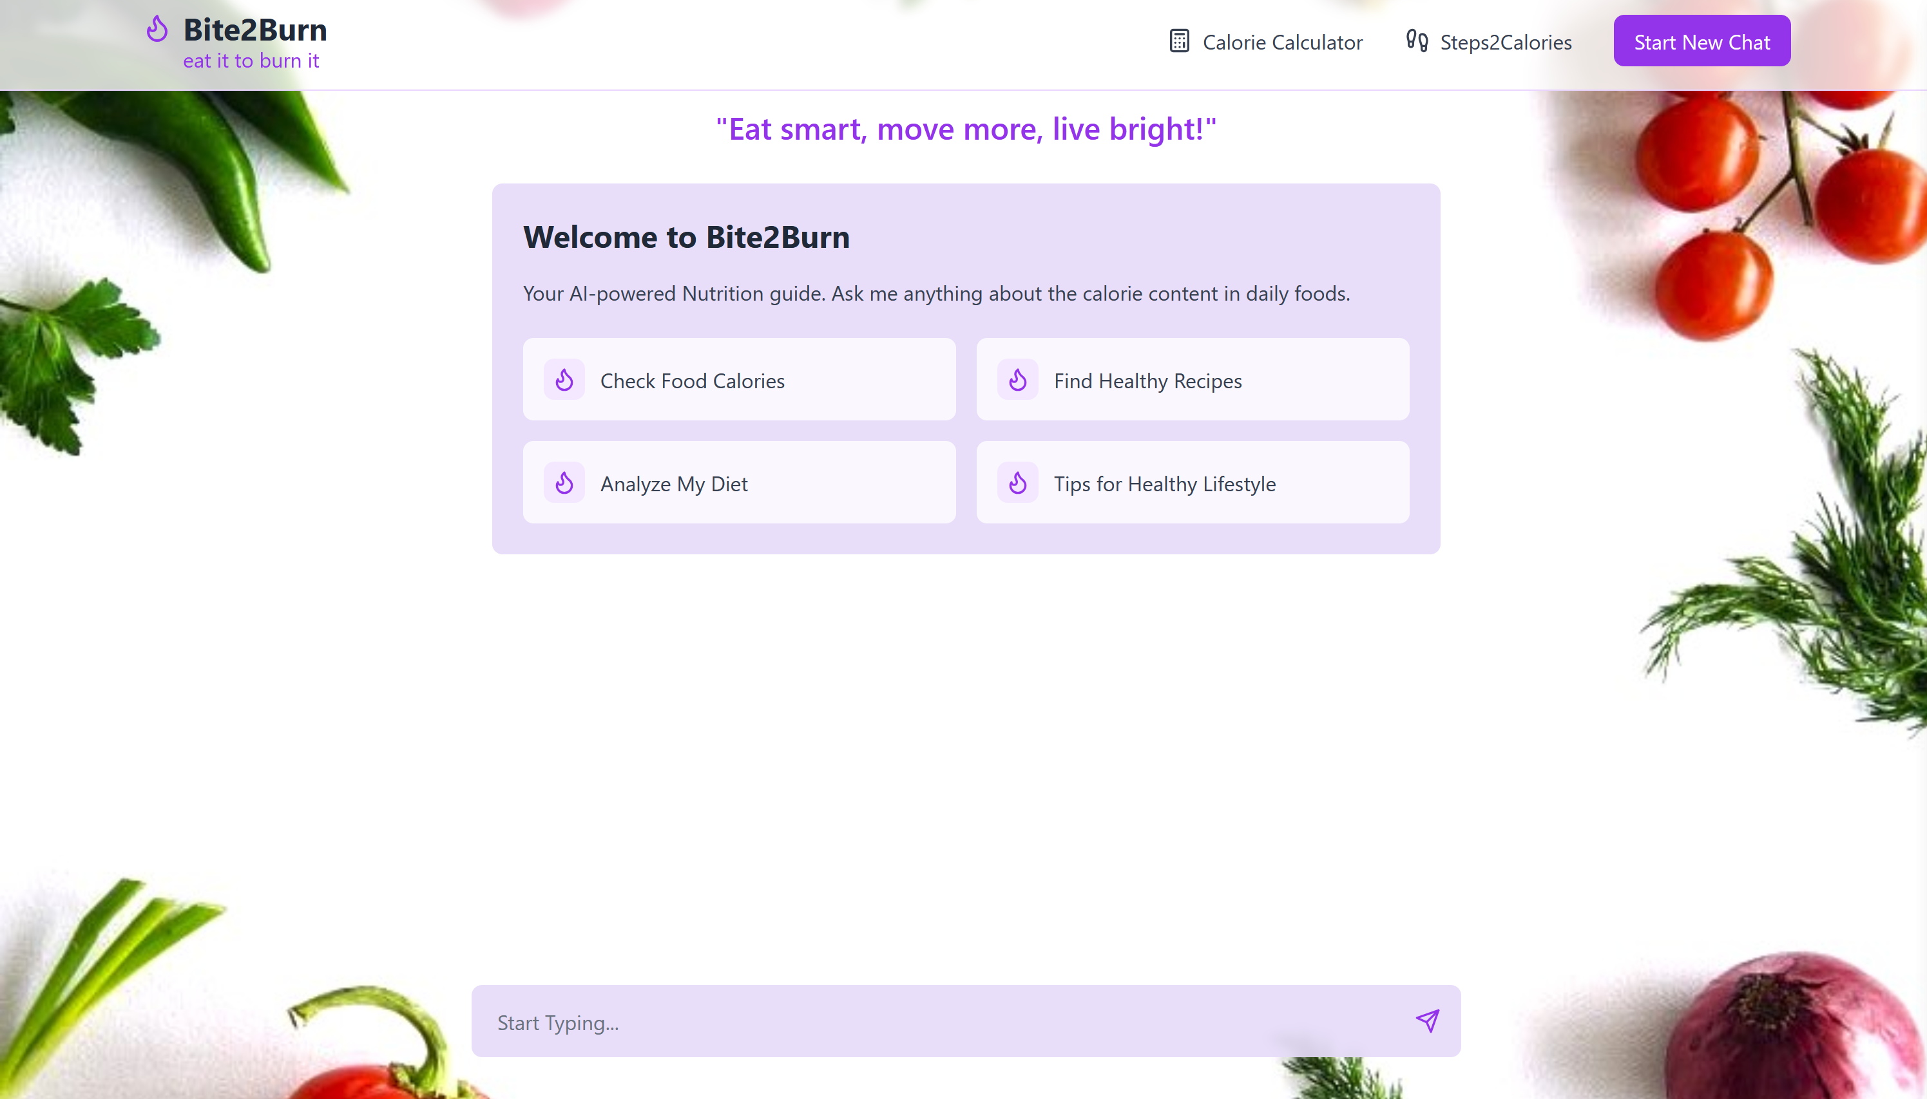
Application Overview: Start Page

Slide 23
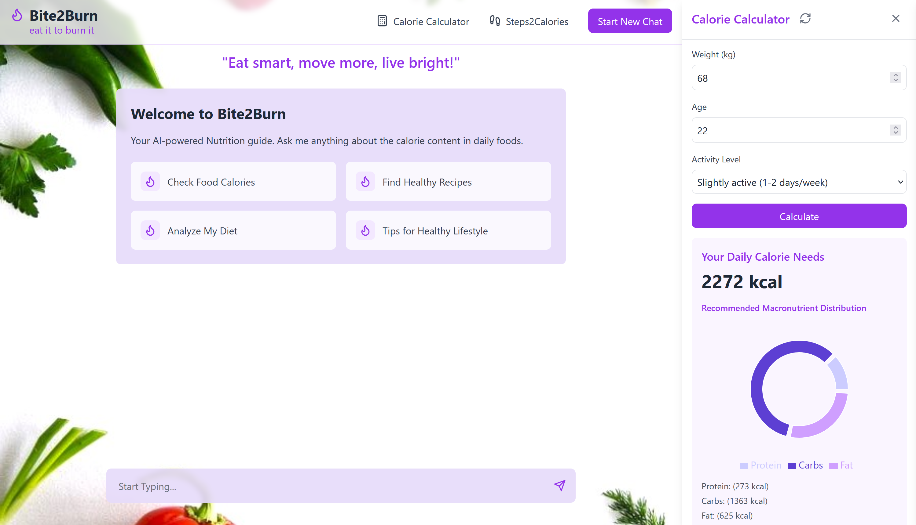
Application Overview: Calorie Calculator

Slide 24
Application Overview: Calorie Calculator
The calorie calculator is based on the Mifflin-St Jeor equation. It allows you to find your basal metabolic rate (BMR) – the amount of energy needed for your body to support only its basic vital functions. It differs for men and women:
BMR(men) = (10 × weight / 1kg + 6.25 × height / 1cm - 5 × age / 1 year + 5) kcal / day
BMR(women) = (10 × weight / 1kg + 6.25 × height / 1cm - 5 × age / 1 year - 161) kcal / day
After you calculate your BMR, you need to multiply it by a factor corresponding to your physical activity level to get your Total daily energy expenditure:
Sedentary lifestyle (little or no exercise): 1.2
Slightly active lifestyle (light exercise or sports 1-2 days/week): 1.4
Moderately active lifestyle (moderate exercise or sports 2-3 days/week): 1.6
Very active lifestyle (hard exercise or sports 4-5 days/week): 1.75
Extra active lifestyle (very hard exercise, physical job or sports 6-7 days/week): 2.0
Professional athlete: 2.3

Slide 25
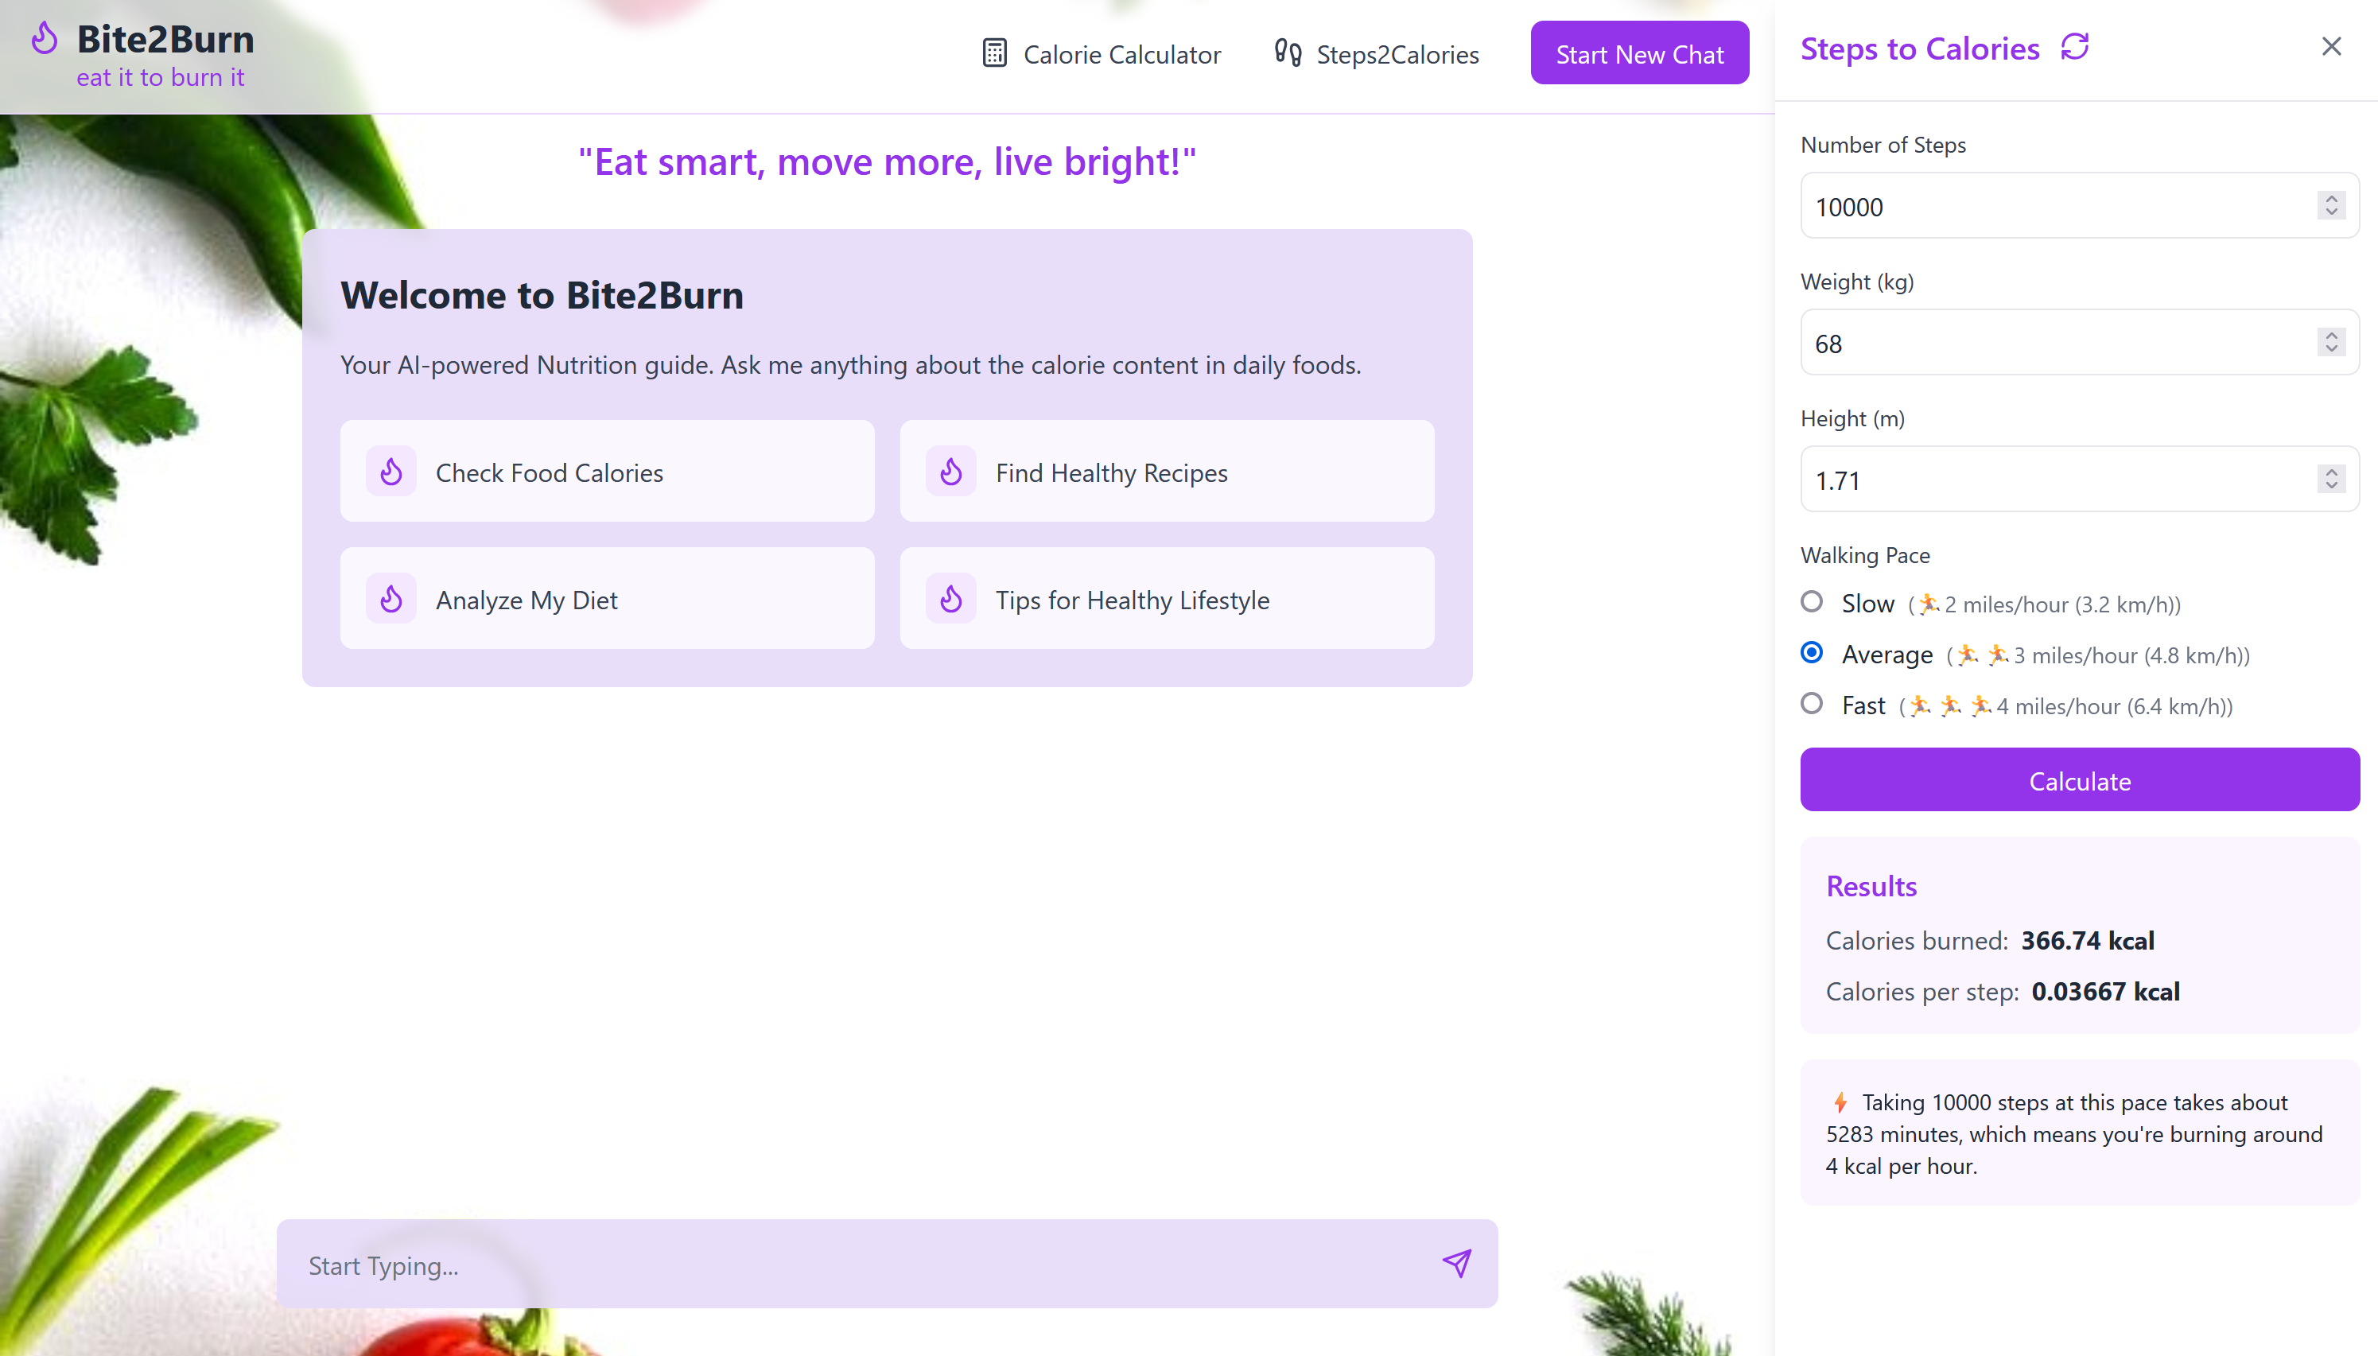
Application Overview: Steps to Calories Calculator

Slide 26
Application Overview: Steps to Calories Calculator
To count calories burned by steps:
You need to know your weight in kilograms, height in meters, how many steps you've taken, and your pace in m/s. You can stick to the general pace values and their MET cofactors:
Slow — 0.9 m/s (2.8 MET);
Average — 1,34 m/s (3.5 MET);
Fast — 1,79 m/s (5 MET).
2. Use the following formulas to calculate the stride and the walked distance.
stride = height × 0.414
distance = stride × steps
3. Calculate the walking time:
time = distance/speed
4. Finally, count the calories burned:
calories = time × MET × 3.5 × weight/(200 × 60)

Slide 27
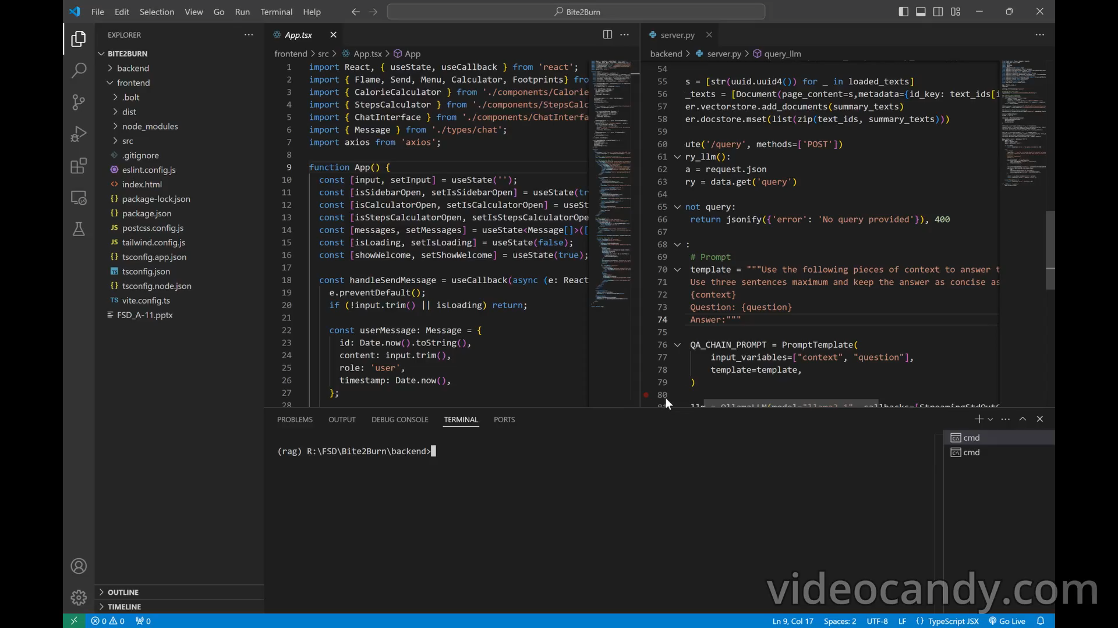
Application Demo

Slide 28
THANK YOU

